Slide 1
PowerPointLabs Test Cases
General instructions:
DO NOT SAVE these slides after testing. Keep this file in its original form.
If your result is different from the expected output, please submit a bug report (attach slides/screenshots as necessary).

Slide 2
Effects Lab

Slide 3
Effects Lab
Ref to Functional Test

Slide 4
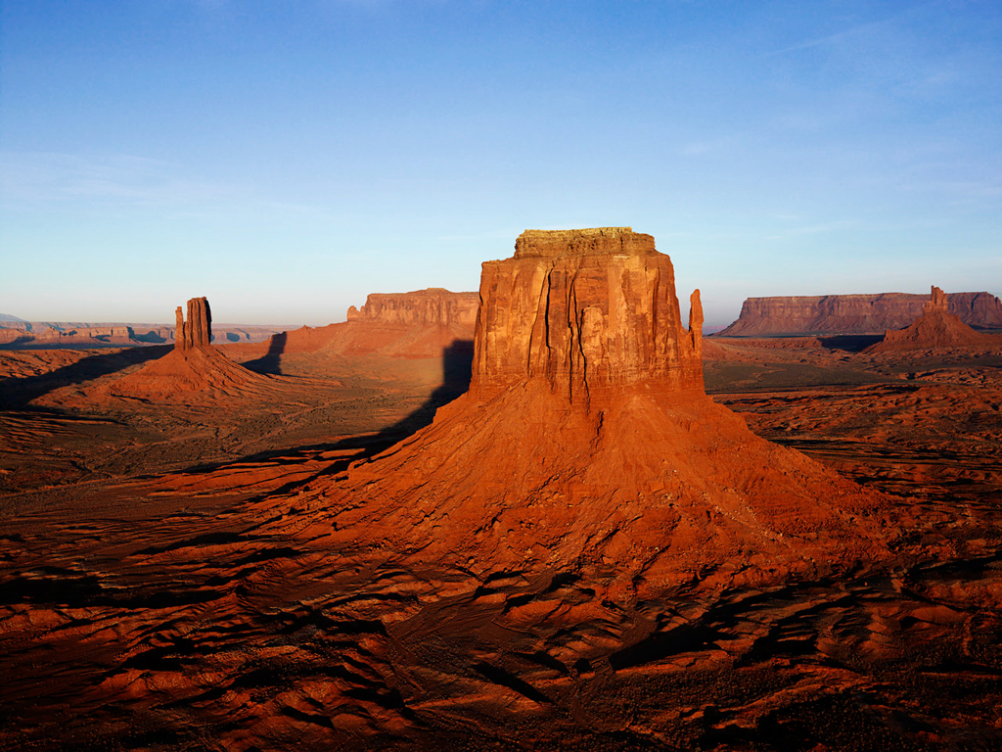
Back

Slide 5

Back
Notes:
Expected: make transparent

Slide 6
Back

Slide 7
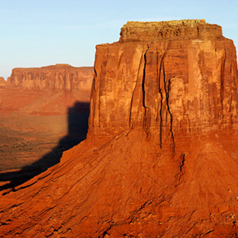
Back
Notes:
Expected: magnifying glass

Slide 8
Back

Slide 9
Back
Notes:
Expected: blur1

Slide 10


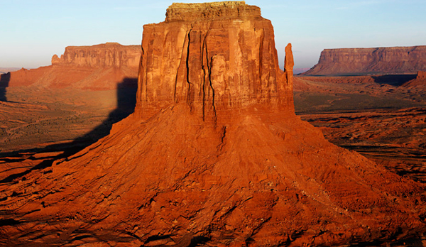
Notes:
Expected: blur2

Slide 11
Back

Slide 12
Back
Notes:
Expected: gray scale1

Slide 13
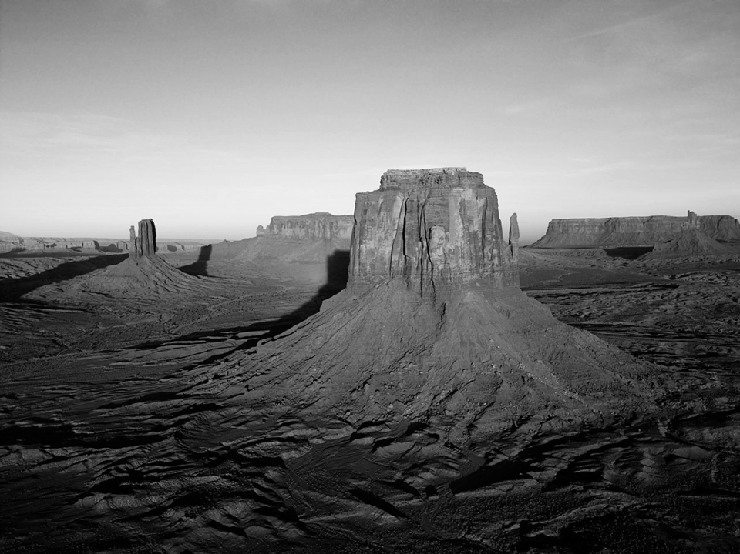
Notes:
Expected: gray scale2

Slide 14
Back

Slide 15
Back
Notes:
Expected: black & white 1

Slide 16
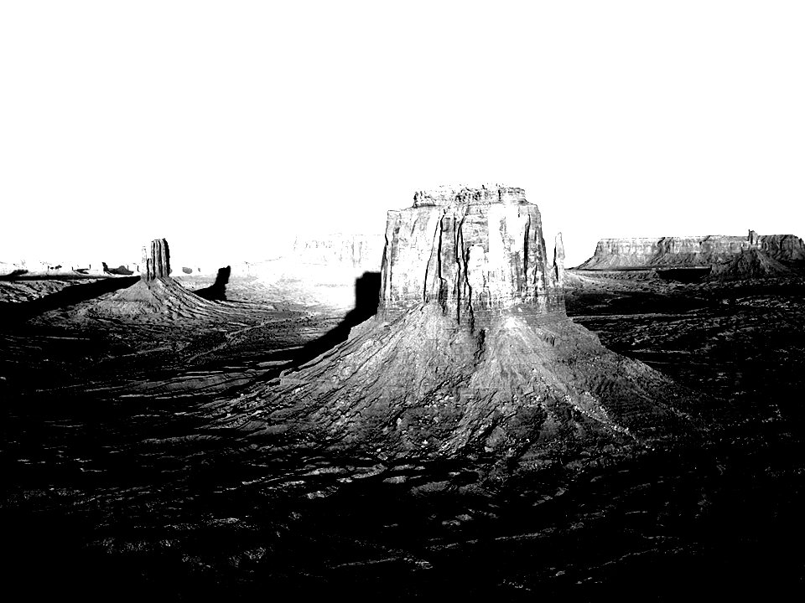
Notes:
Expected: black & white 2

Slide 17
Back

Slide 18
Back
Notes:
Expected: Gotham1

Slide 19
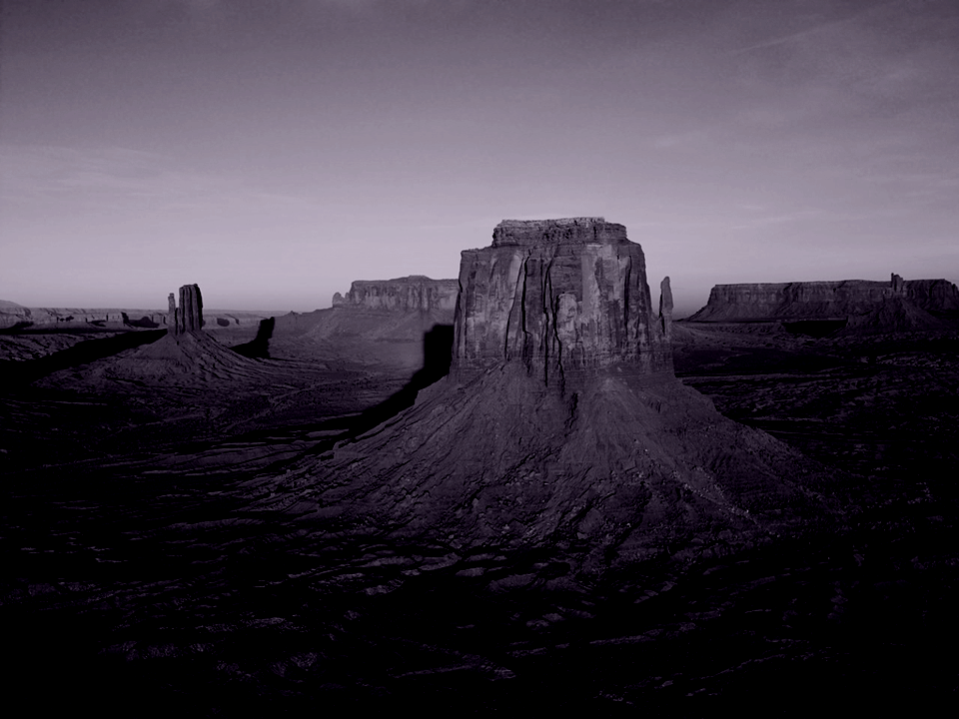
Notes:
Expected: Gotham2

Slide 20
Back

Slide 21
Back
Notes:
Expected: sepia1

Slide 22
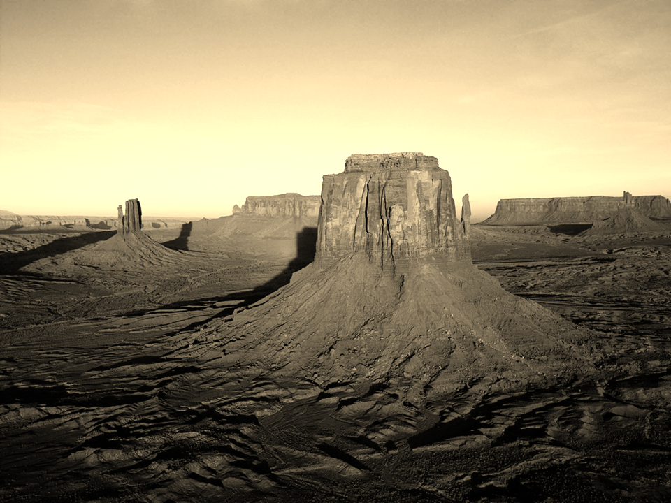
Notes:
Expected: sepia2

Slide 23
